Slide 1
Presentation On Project Report Heart Disease prediction using Datamining Technique
Present By
Md Mahmudul Hasan 201015083
Most.Jannati Khatun 201015041

Slide 2
Content
Introduction
Objectives
Features
Project Code and Output
Conclusion

Slide 3
Introduction
The heart is a most significant muscular organ in humans, which pumps blood through the blood vessels of the circulatory system [l]. Human life is dependent on the proper functioning of heart. Improper functioning of heart will influence other parts of human body like brain, kidney etc. If the blood circulation in body is inefficient, it affects both heart and brain. Generally blood arrest in heart is called as attack and blood arrest in brain is called as stroke.
Human life is absolutely reliant on the efficient working of the heart and brain. The rest of this paper is presented as follows: Section 2 describes the cardiovascular disease and its pervasiveness. Section 3 describes the advantage of decision support system for the prediction of heart disease. Section 4 and 5 describes various data mining and hybrid intelligent techniques used for the prediction of heart disease.

Slide 4
Objective
The main objective of the Project is to predict more accurately Incidence of heart disease using data mining techniques.
The use of appropriate technology support in this regard can prove highly beneficial to the medical community and patients.
Clearly state the objective of the presentation: to demonstrate the effectiveness of data mining techniques in predicting heart disease.
Lack of medical resources can sometimes make it difficult to predict heart disease.
Explain the potential impact of accurate heart disease prediction on early diagnosis and intervention.

Slide 5
Features
A. Age: The age of the patient is an important factor as heart disease risk increases with age.
B. Gender: There are differences in heart disease prevalence between males and females, making gender an important feature.
C. Chest Pain Type: Different types of chest pain can provide valuable information.
D. Cholesterol Levels: High levels of total cholesterol, low-density lipoprotein (LDL) cholesterol, and triglycerides, as well as low levels of high-density lipoprotein (HDL) cholesterol, are associated with an increased risk of heart disease.
E. Heart Disease frequency frequency features can provide valuable insights into the occurrence and patterns of certain events or conditions.

Slide 6
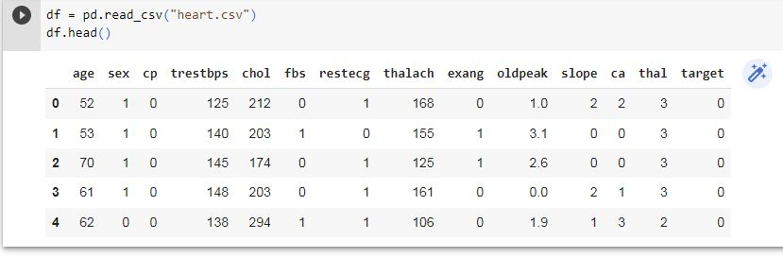
Project Code and Output:

Slide 7
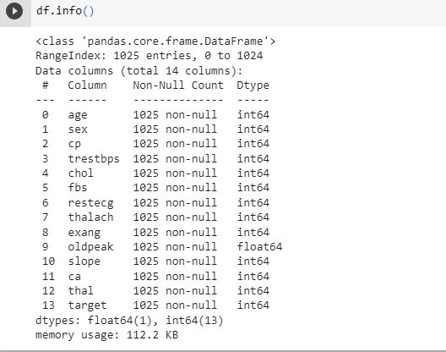
Project Code and Output:

Slide 8
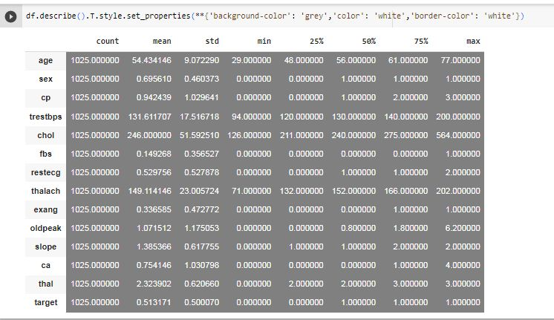
Project Code and Output:

Slide 9
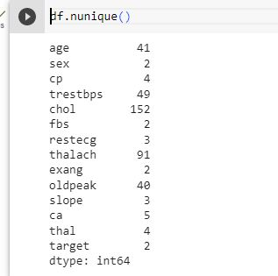
Project Code and Output:

Slide 10
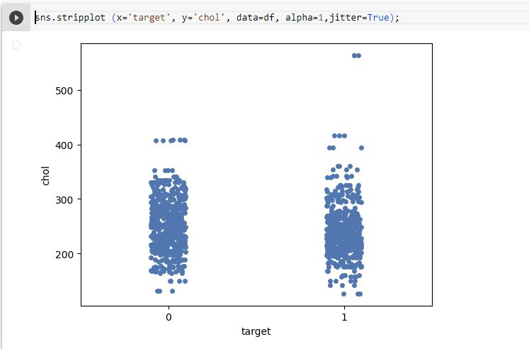
Project Code and Output:

Slide 11
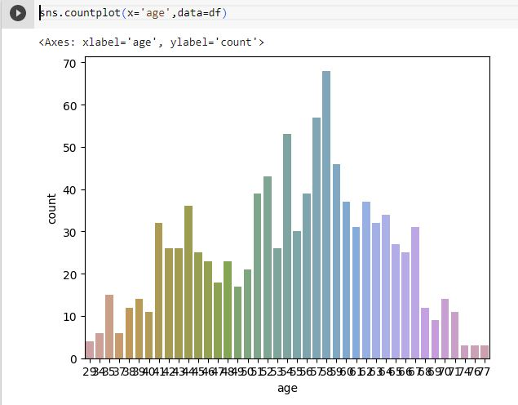
Project Code and Output:

Slide 12
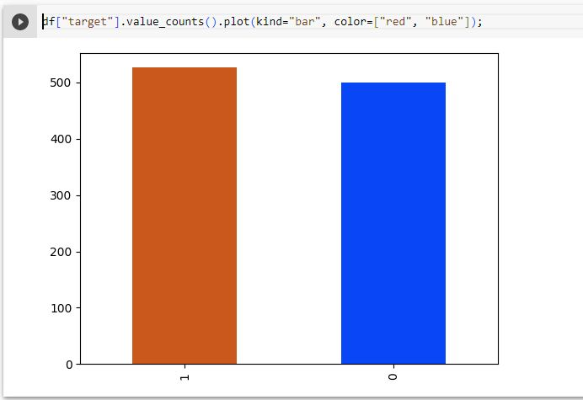
Project Code and Output:

Slide 13
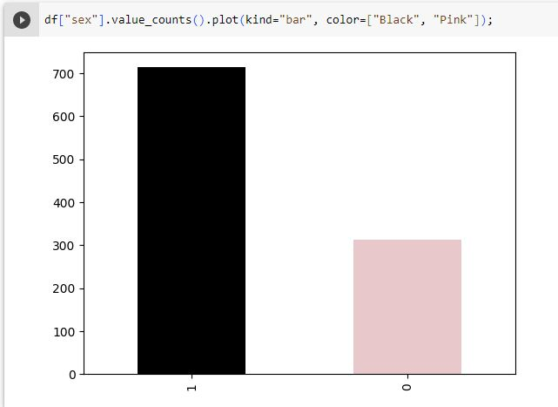
Project Code and Output:

Slide 14
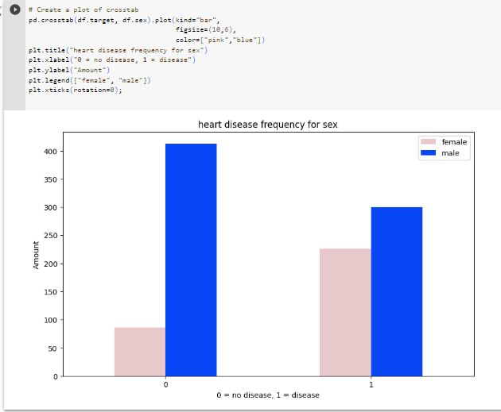
Project Code and Output:

Slide 15
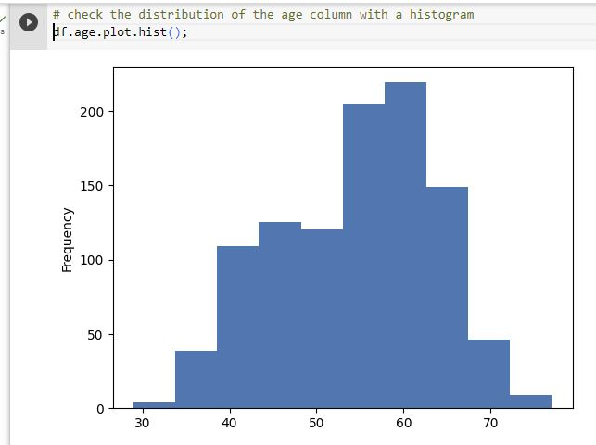
Project Code and Output:

Slide 16
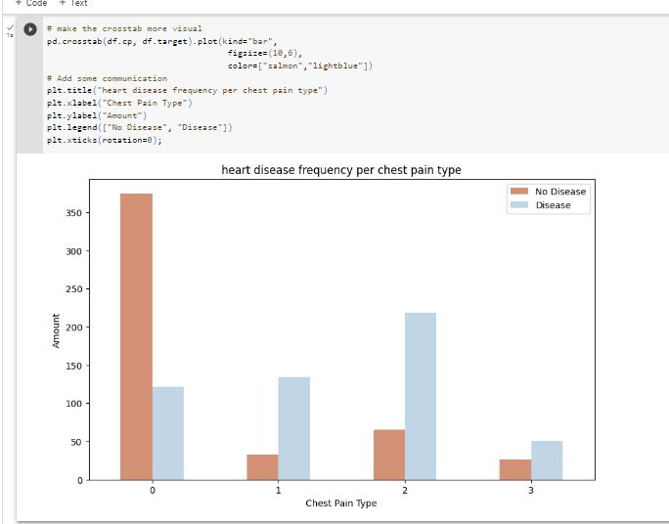
Project Code and Output:

Slide 17
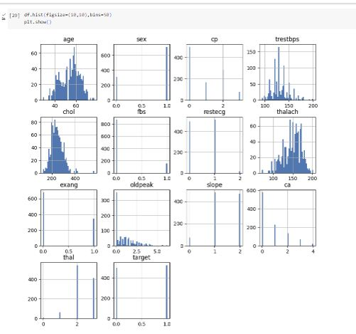
Project Code and Output:

Slide 18
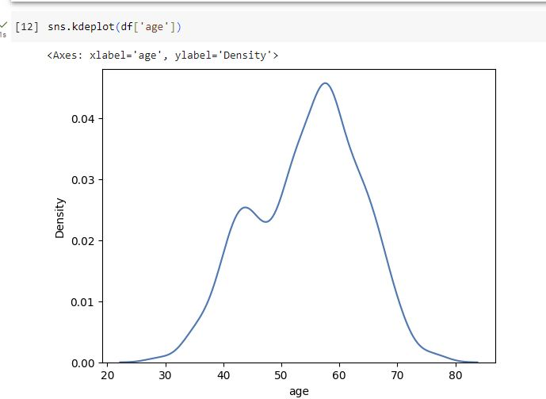
Project Code and Output:

Slide 19
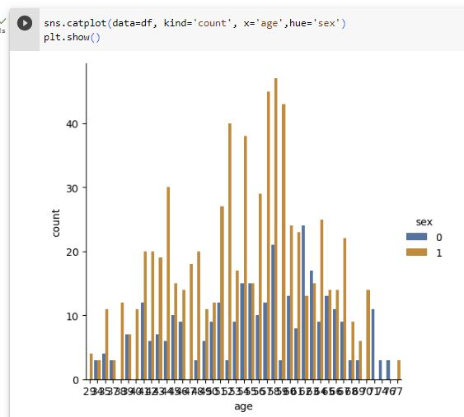
Project Code and Output:

Slide 20
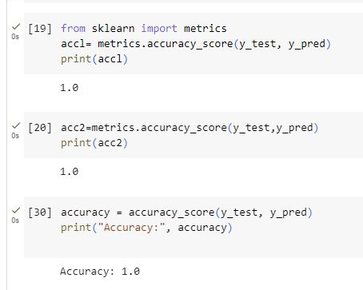
Project Code and Output:

Slide 21
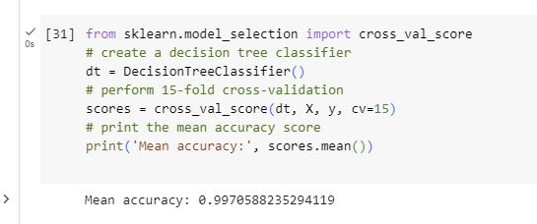
Project Code and Output:

Slide 22
Conclusion
The overall objective of the work is to predict more accurately Incidence of heart disease using data mining techniques.
There are comparative analysis of three algorithms such as random Forests, decision trees and nave bays. From research work, It has been experimentally proven that random forests provide Perfect results compared to Decision Trees and Naive Bayes.
The Future work of this research work can be made to produce an impact in the accuracy of the Decision Tree and Bayesian Classification for additional improvement after applying genetic algorithm in order to decrease the actual data for acquiring the optimal subset of attribute that is enough for heart disease prediction. The automation of heart disease prediction using actual real time data from health care organizations and agencies which can be built using big data.

